Slide 1
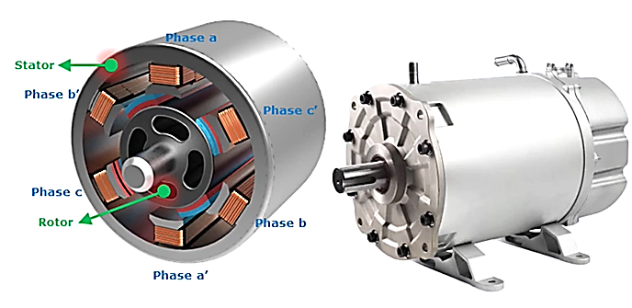
Permanent Magnet Synchronous Motor
Similar to BLDC motor
High power density and efficiency
Best choice for Cars, Buses
Stiff competition to induction motors
Expensive
Many auto manufacturers uses PMSM like Ford Focus Electric, Nissan Leaf, MG ZS, Hyundai Kona and many more

